Slide 1
Scatter Diagrams Revision
Paper 1: Spearman’s rank correlation coefficient
Spearman’s and Pearson’s coefficients
Paper 2: Correlation
Lines of best fit
SPEARMAN’S RANK CORRELATION COEFFICENT
PEARSON’S CORRELATION COEFFCIENT
CORRELATION AND LINES OF BEST FIT

Slide 2
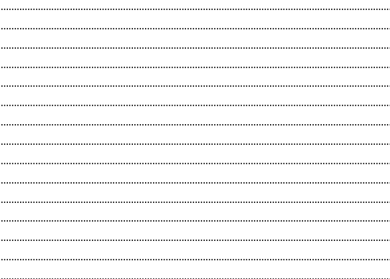
1
Below is the data for 8 runners’ personal bests for a 5km race and a 10 km race
Runner | 5 km time | 10 km time
A | 00:18:38 | 00:44:30
B | 00:42:34 | 01:21:21
C | 00:30:54 | 00:54:07
D | 00:33:25 | 00:49:16
E | 00:22:57 | 00:50:01
F | 00:37:32 | 01:25:55
G | 00:17:05 | 00:47:49
H | 00:50:03 | 01:56:48
Calculate Spearman’s rank correlation coefficient for this data.
Interpret this value of the Spearman’s rank correlation coefficient.
The 10km time for runner D has been recorded incorrectly. It should be 00:59:16
Without any further calculation, explain whether the value of the Spearman’s rank correlation coefficient will be larger, smaller or stay the same.

Slide 3
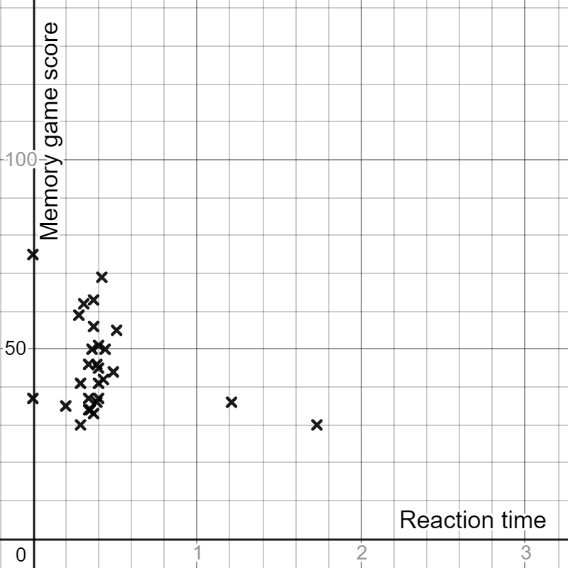
2
Below is the scatter graph of data showing students reaction time against their memory game score.
Explain how you can tell this data has not been cleaned?
The Pearson’s correlation coefficient for this data once it has been cleaned is -0.272
Interpret this value in context.

Slide 4
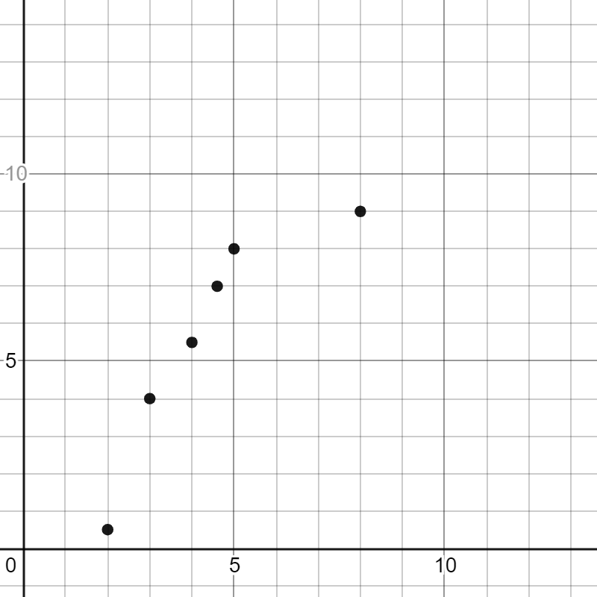
3
Frida has calculated the Spearman’s rank and Pearson’s correlation coefficient for this data.
She has written down values of 0.89 and 1, but forgot to write which was which.
Explain, with reasoning, which is which value:
Spearman’s rank correlation coefficient:
Pearson’s correlation coefficient:

Slide 5
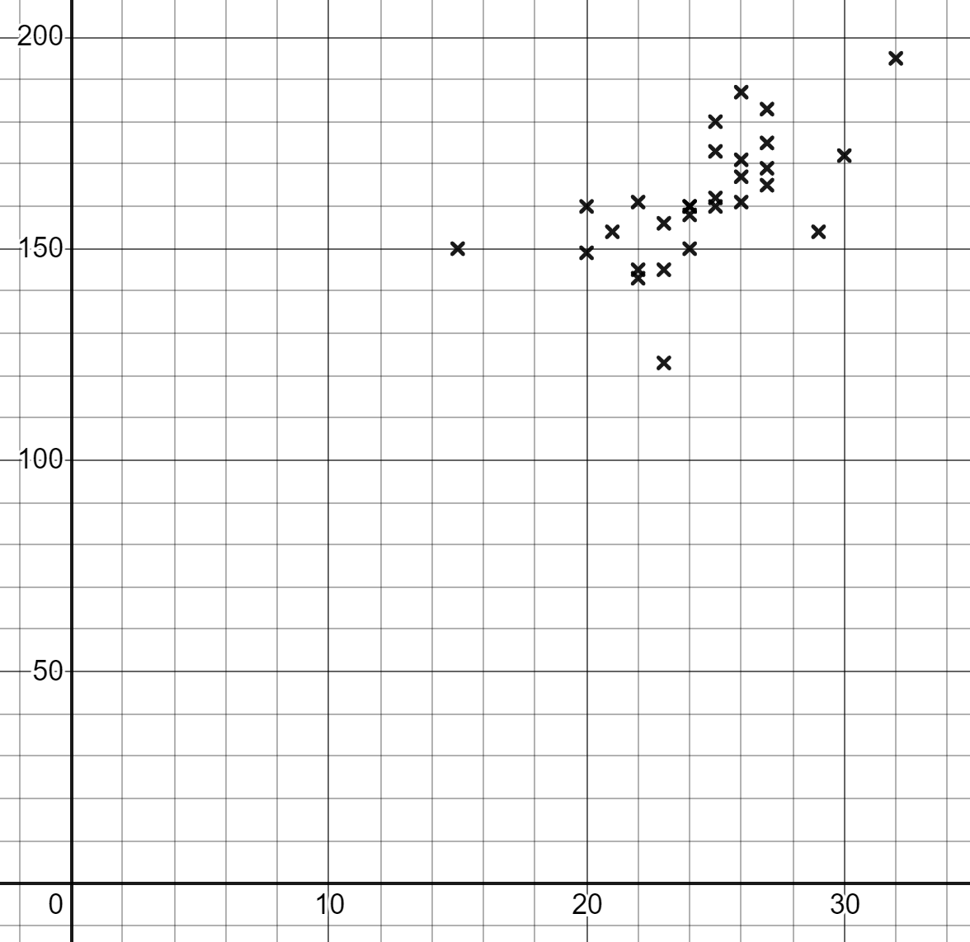
4
The following scatter graph shows foot length against arm span.
Arm span(cm)
Foot length (cm)
The mean point is (24.5, 161.7)
Draw a line of best fit on the scatter diagram and work out the equation of this line.

Slide 6
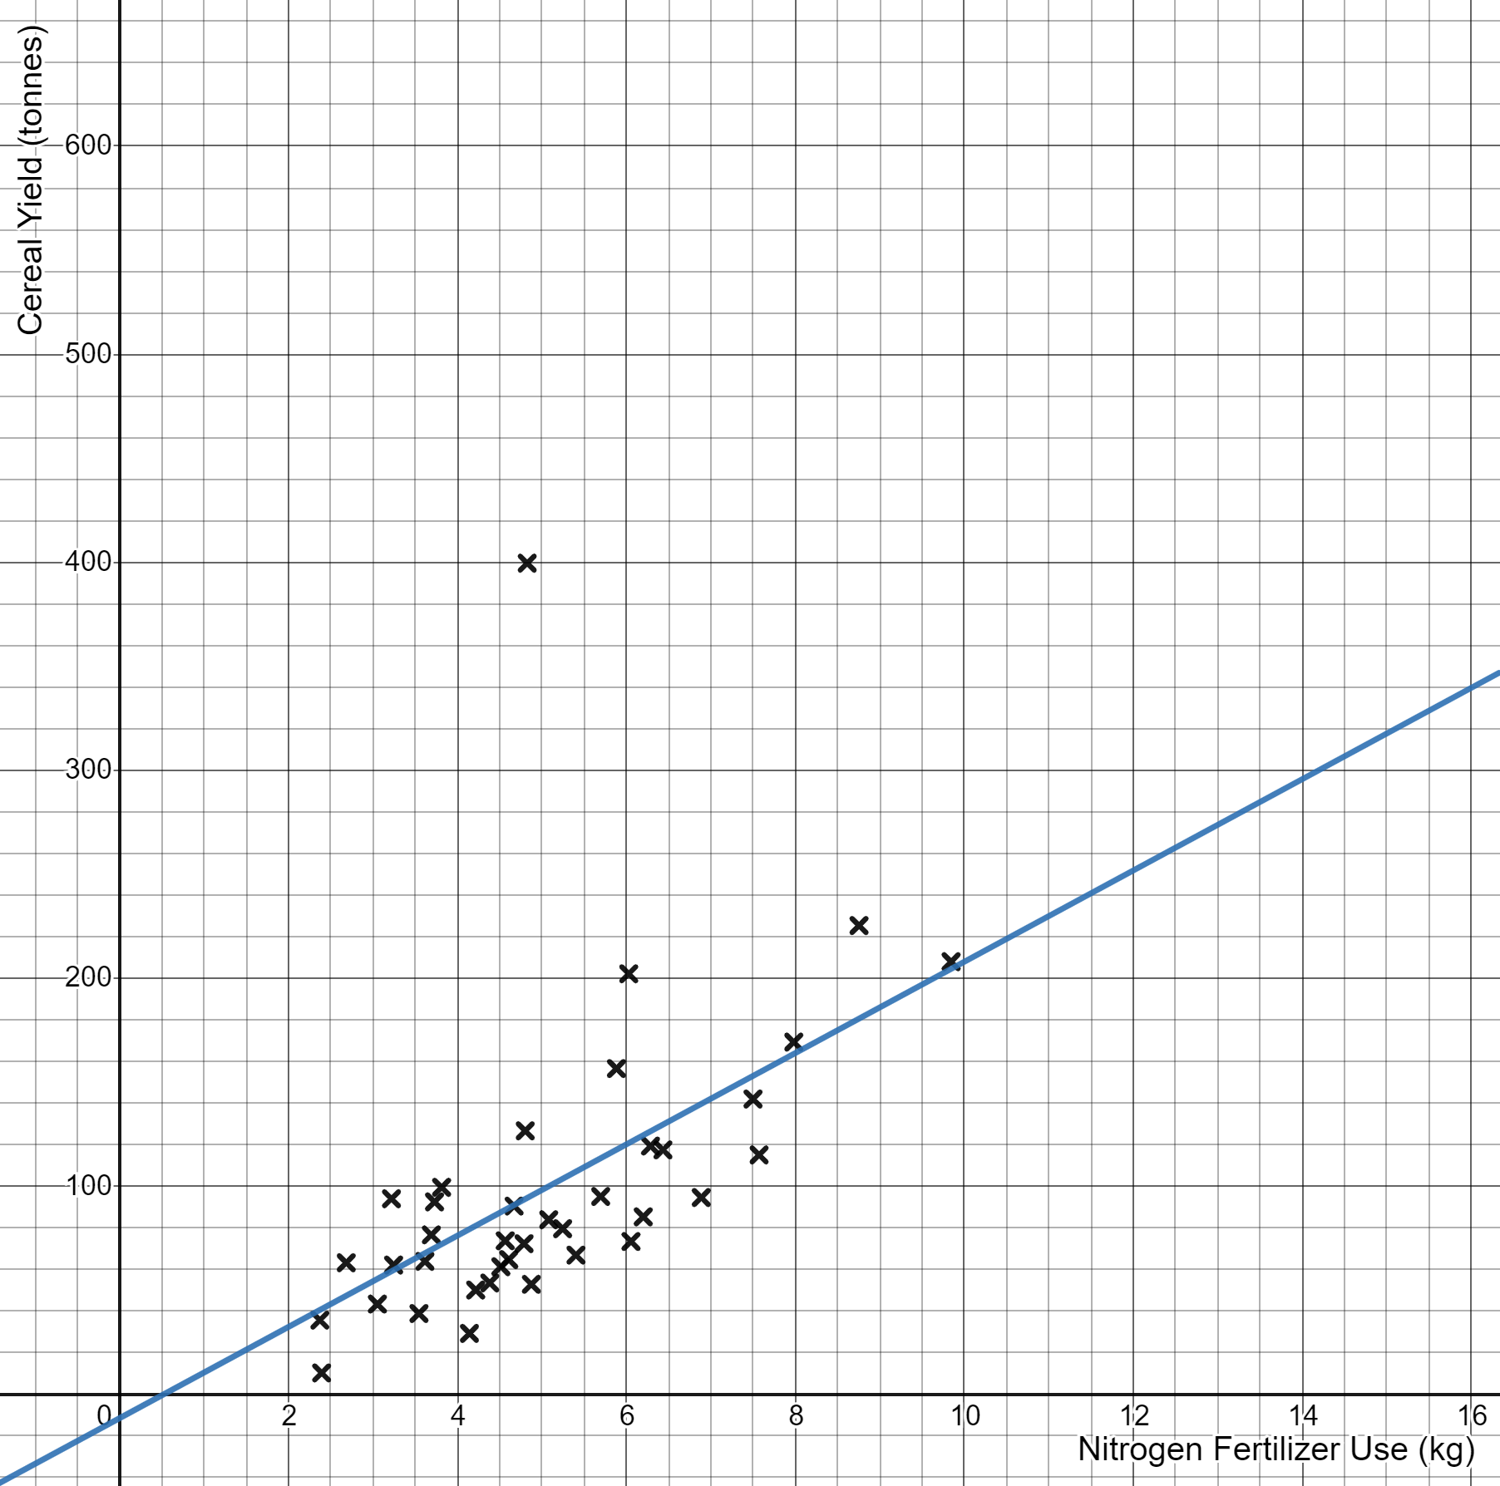

5
The following scatter graph shows crop yield versus fertilizer use for the European countries in 2015.
Source: UN Food and Agriculture Organization
The equation of the line of best fit shown on the graph is
$$y=21.9x−11.5$$
Interpret the coefficient 21.9
Interpret the constant $−11.5$

